Slide 1
AeroMedical Factors
          A valid Medical Certificate is required to exercise the privileges
          of most Airman Certificates 14 CFR 61.53
          Pilots should be aware of certain Medical Factors
          that may affect pilot performance while flying PHAK 17-2

Slide 2
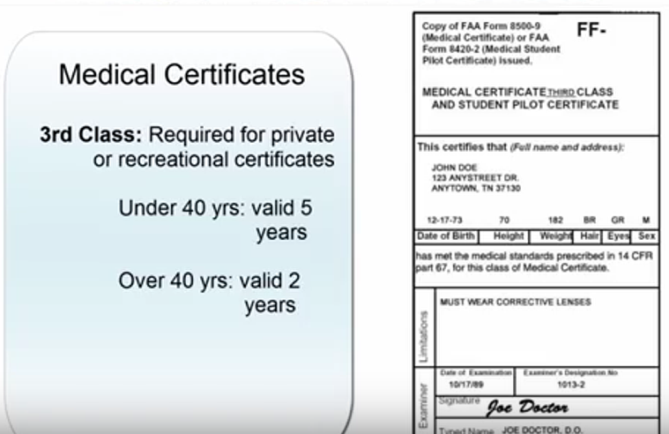
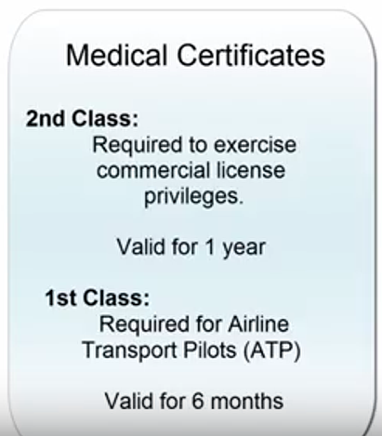
Medical Certificates
ATP 1st Class
< 40 yrs old – valid for 12 months
> 40 yrs old – valid for 6 months

Slide 3
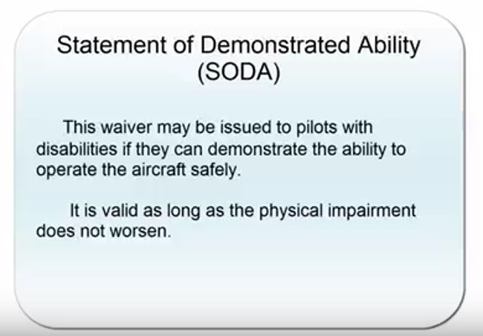
Waiver to Physical Limitations

Slide 4
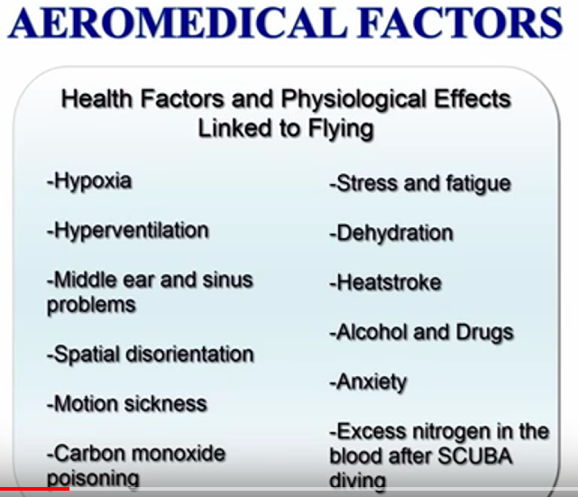

Slide 5
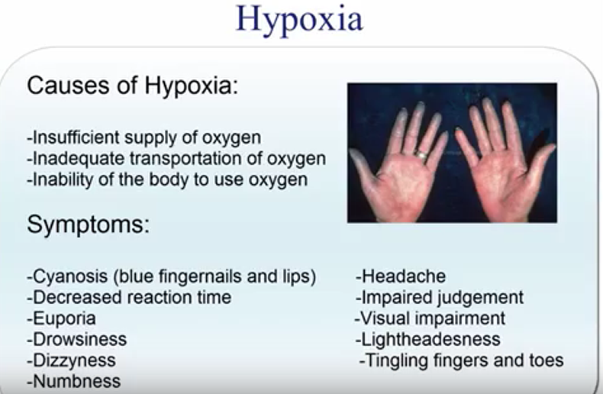

Slide 6
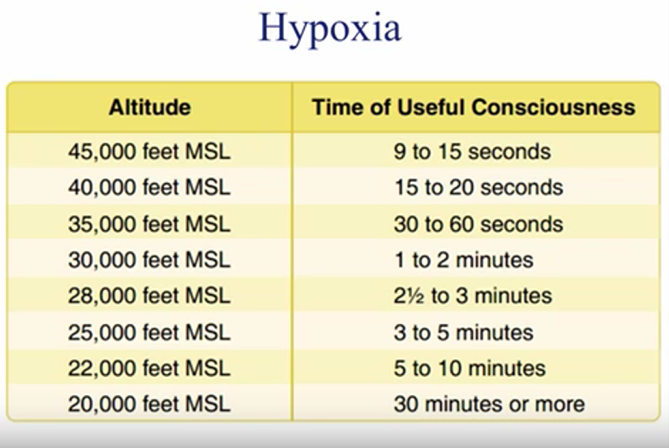
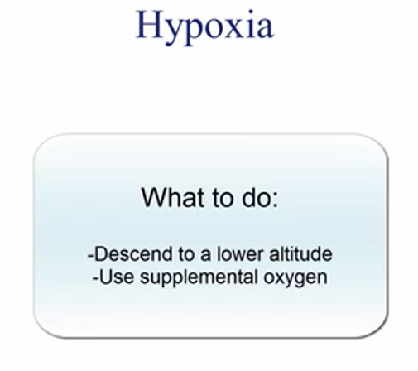

Slide 7
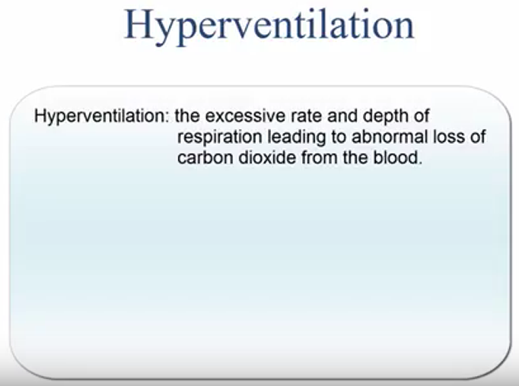

Slide 8
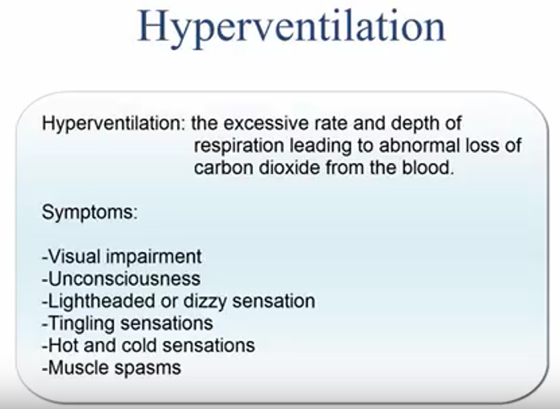

Slide 9
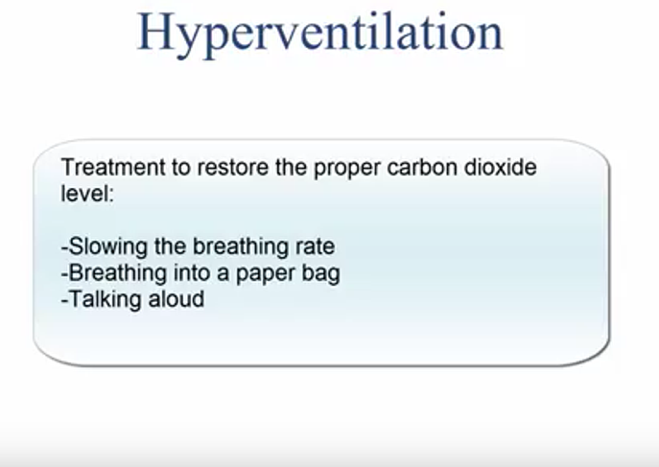

Slide 10
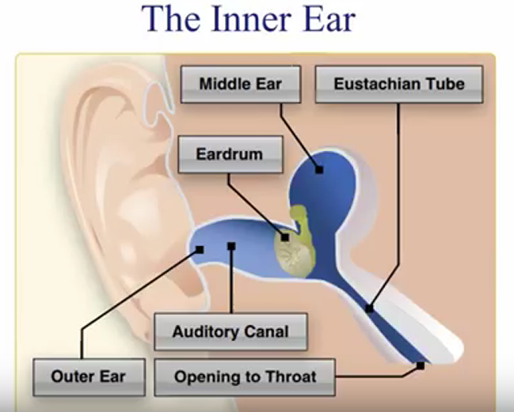
Middle Ear and Sinus Problems

Slide 11
Spatial Disorientation and Illusions
  Body uses three integrated systems that work together to
  ascertain orientation and movement in space:
      Vestibular System
        - organs found in the inner ear
        - sense position from balance
      Somatosensory System
        - nerves, muscles, joints, hearing
        - sense position based on gravity, feeling, and sound
      Visual System
        - Eyes
        - sense position based on what is seen

Slide 12
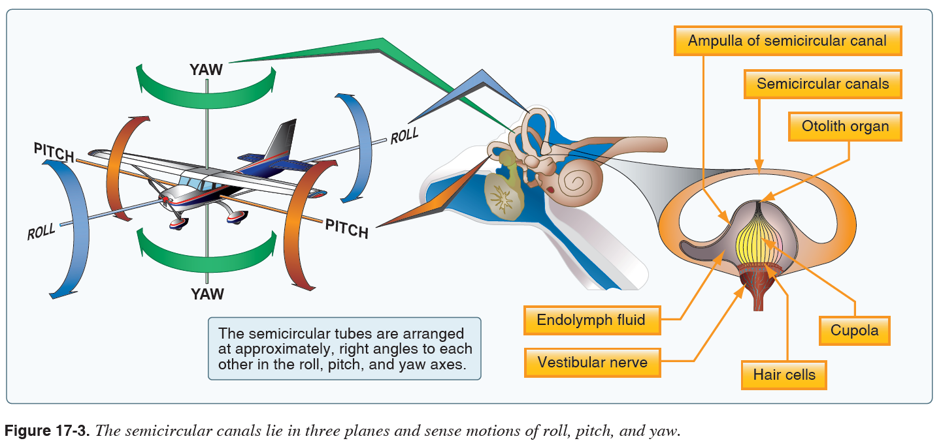

Slide 13
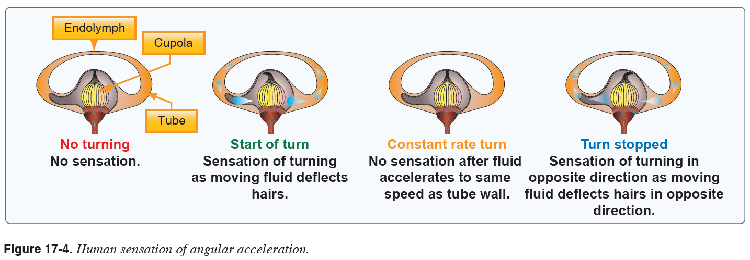

Slide 14
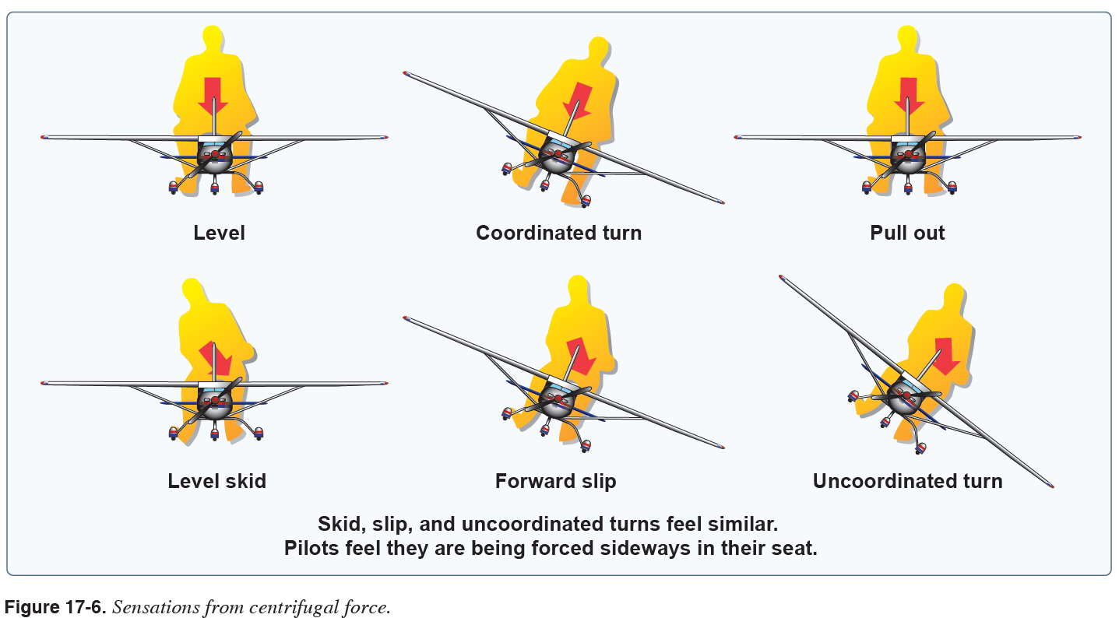

Slide 15
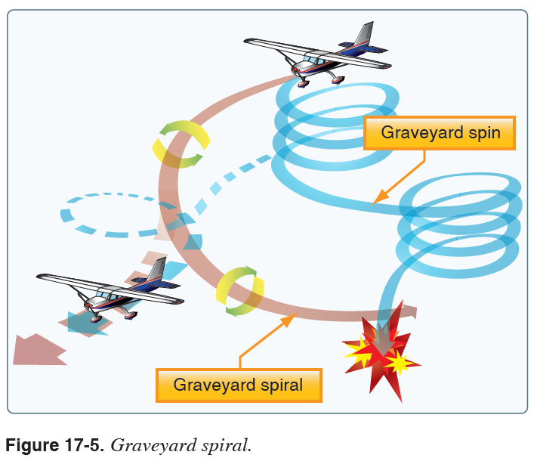

Slide 16
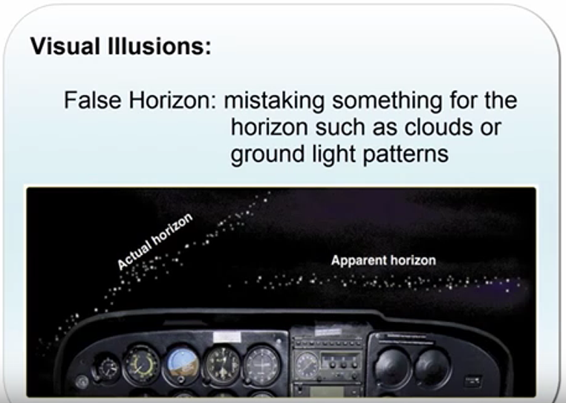

Slide 17
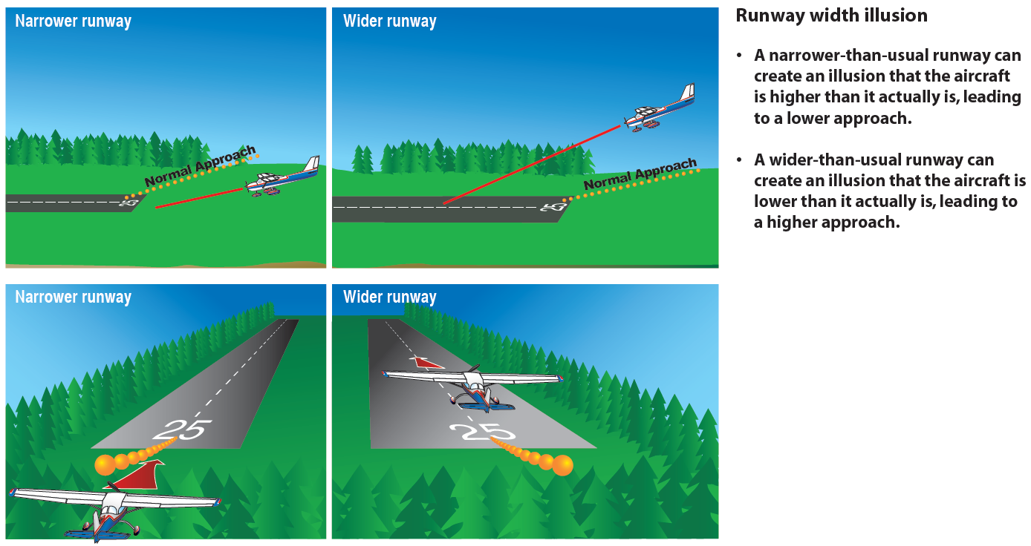

Slide 18
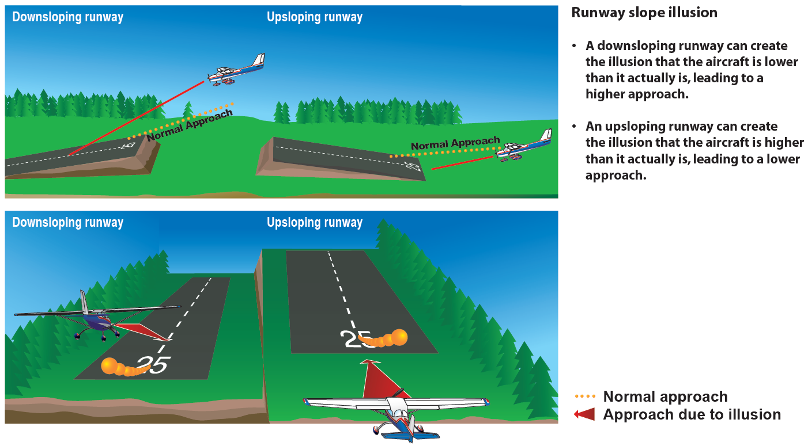

Slide 19
Motion Sickness
Carbon Monoxide Poisoning
Fatigue and Stress
Dehydration
PHAK 17-12

Slide 20
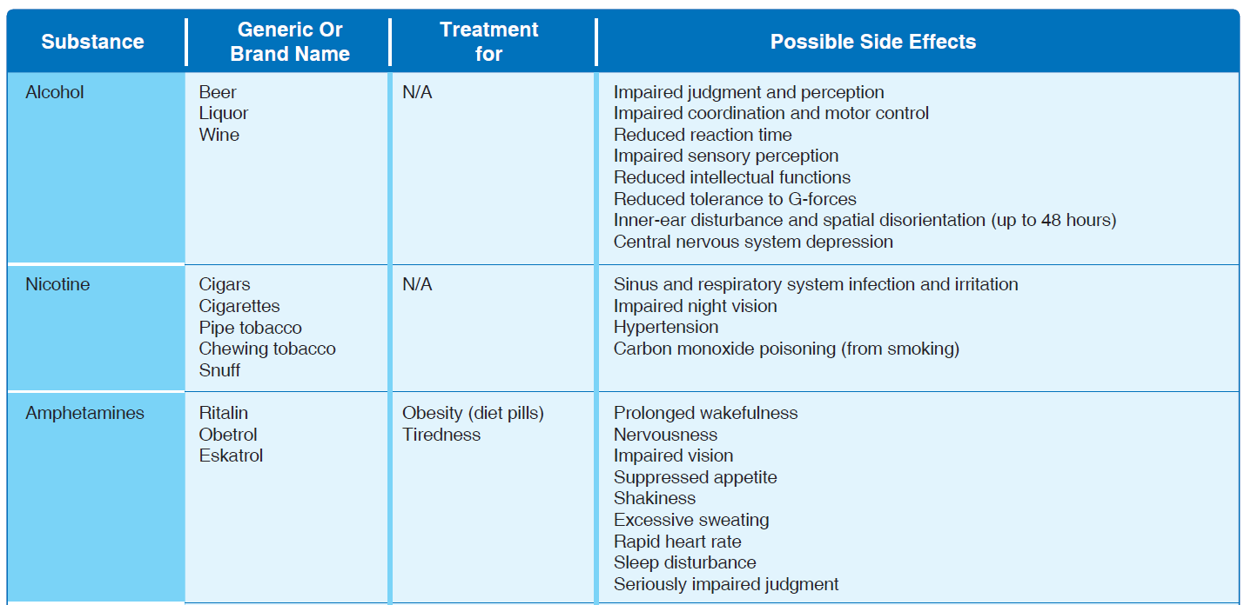
Effects of alcohol & drugs

Slide 21
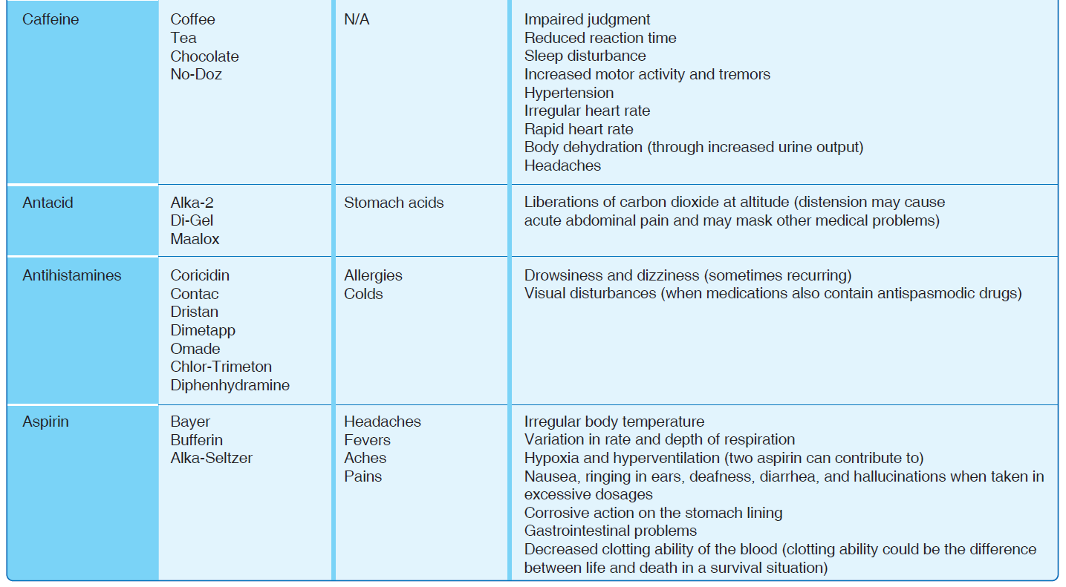

Slide 22

Effect of nitrogen excesses incurred during scuba diving

Slide 23
